Slide 1
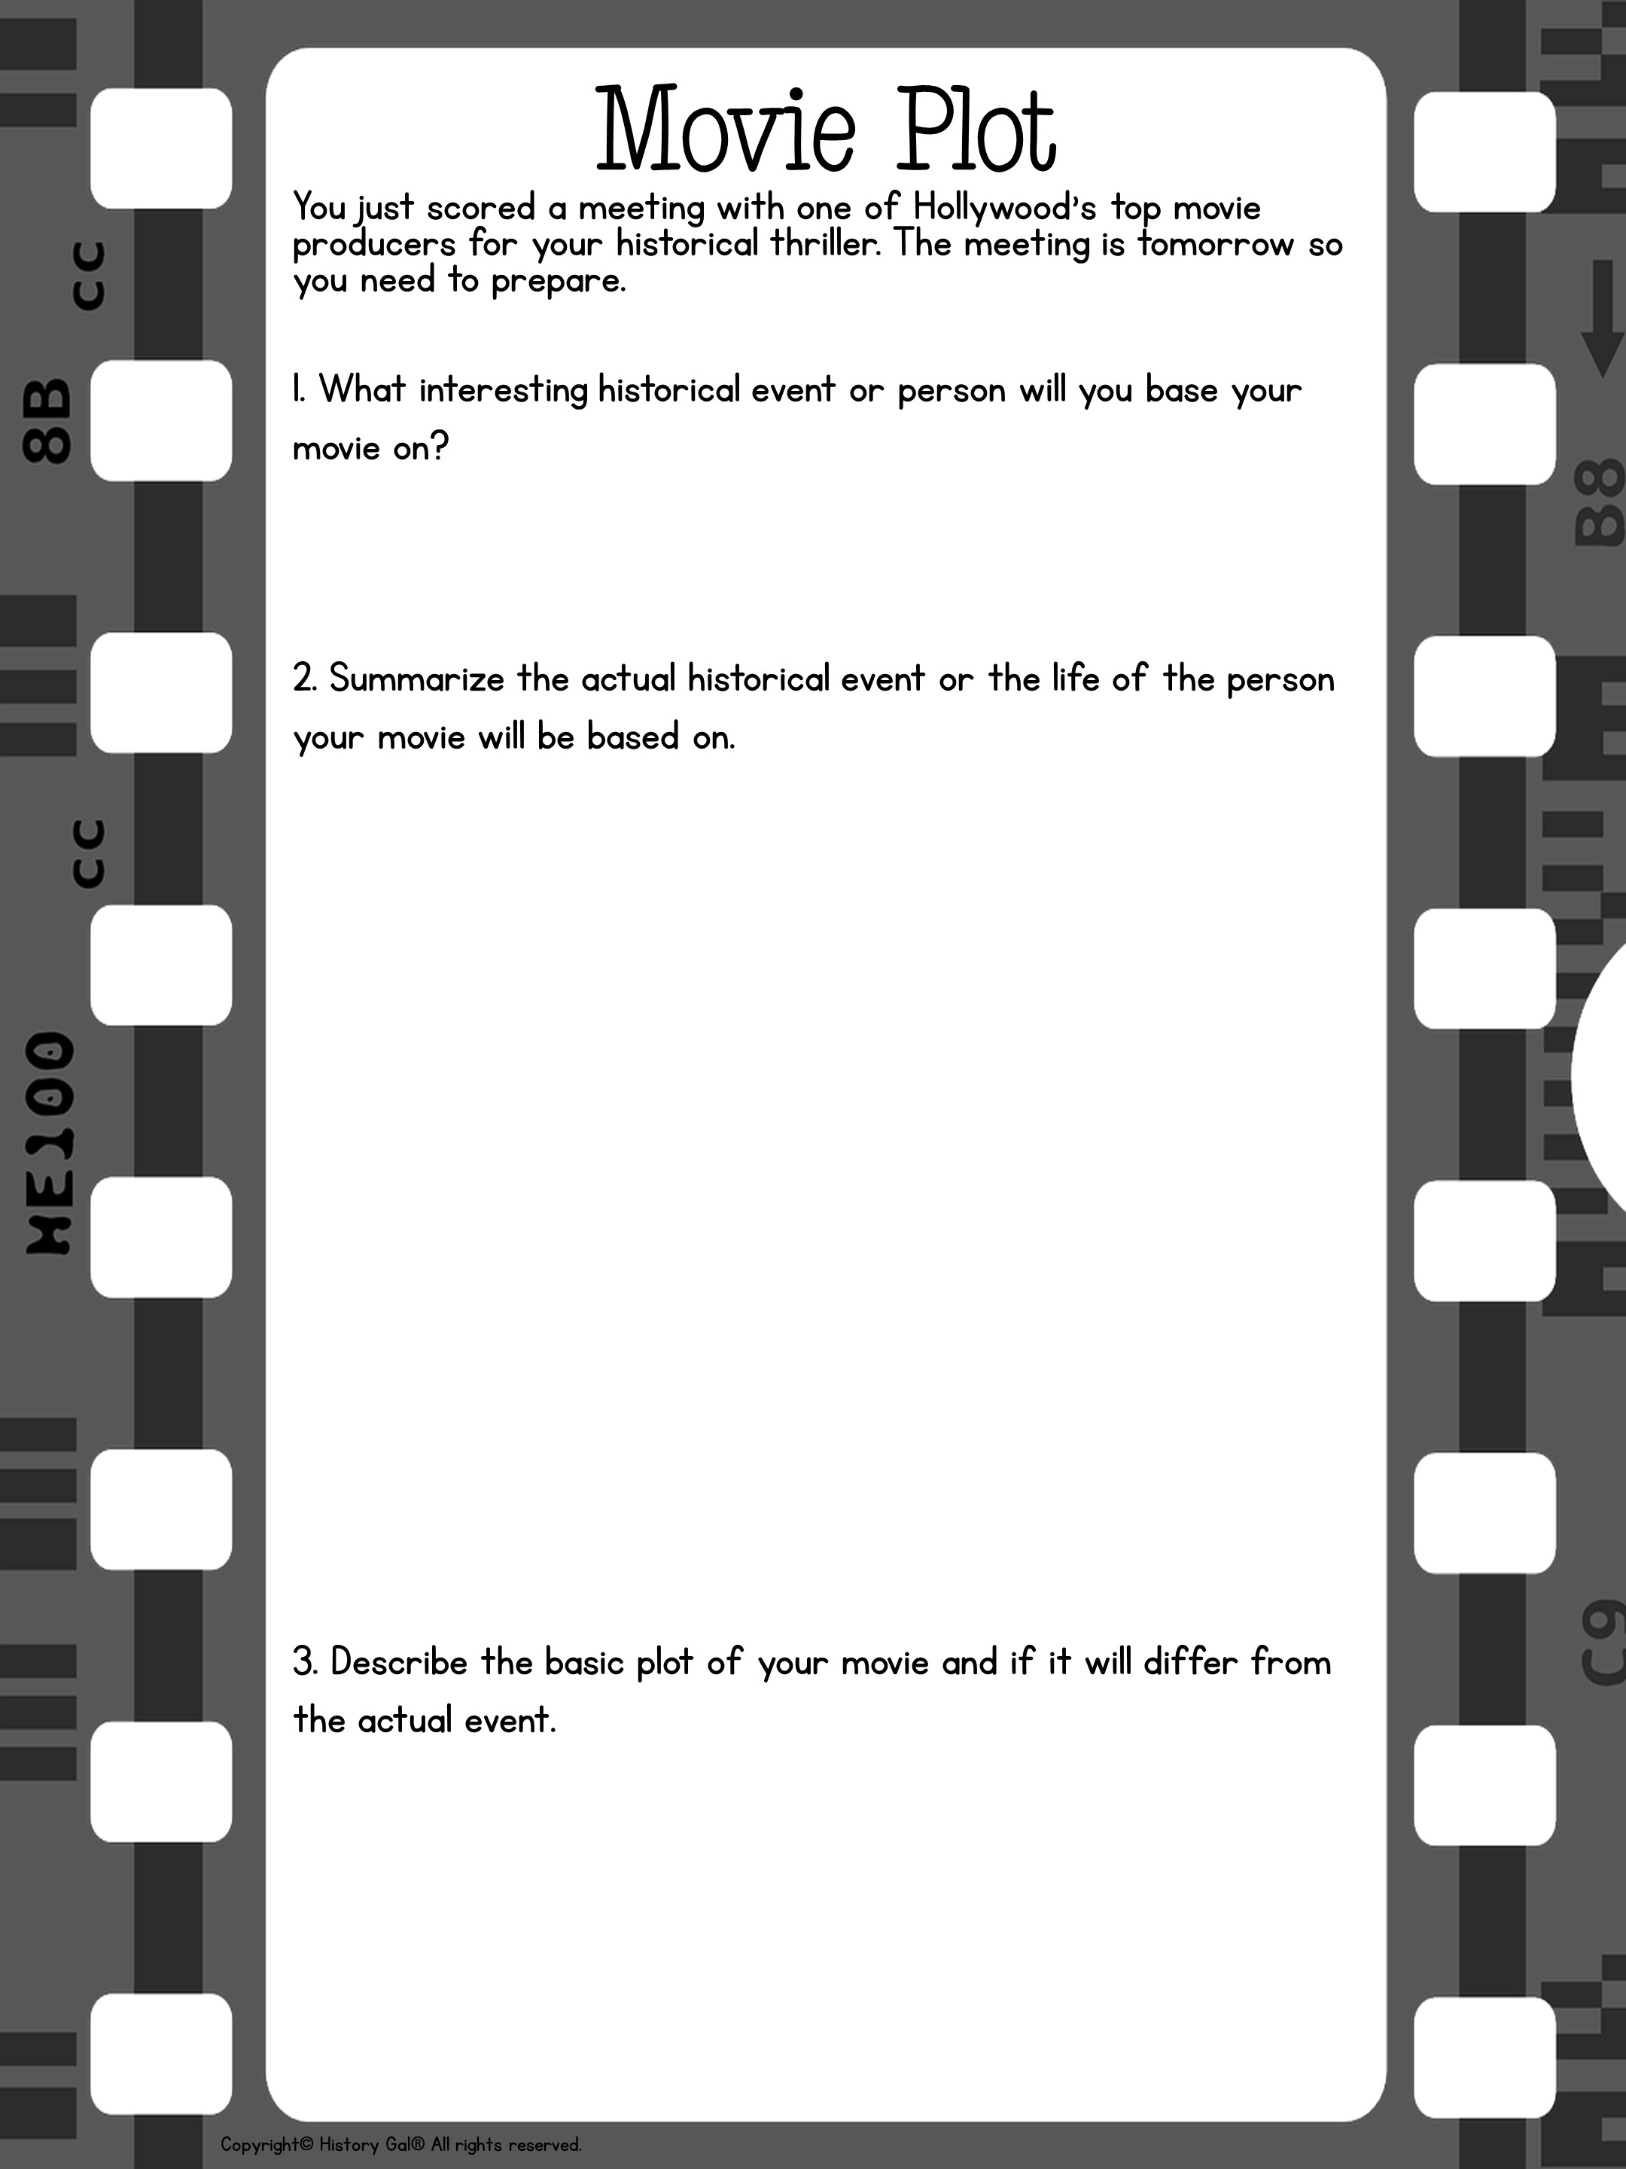

Slide 2
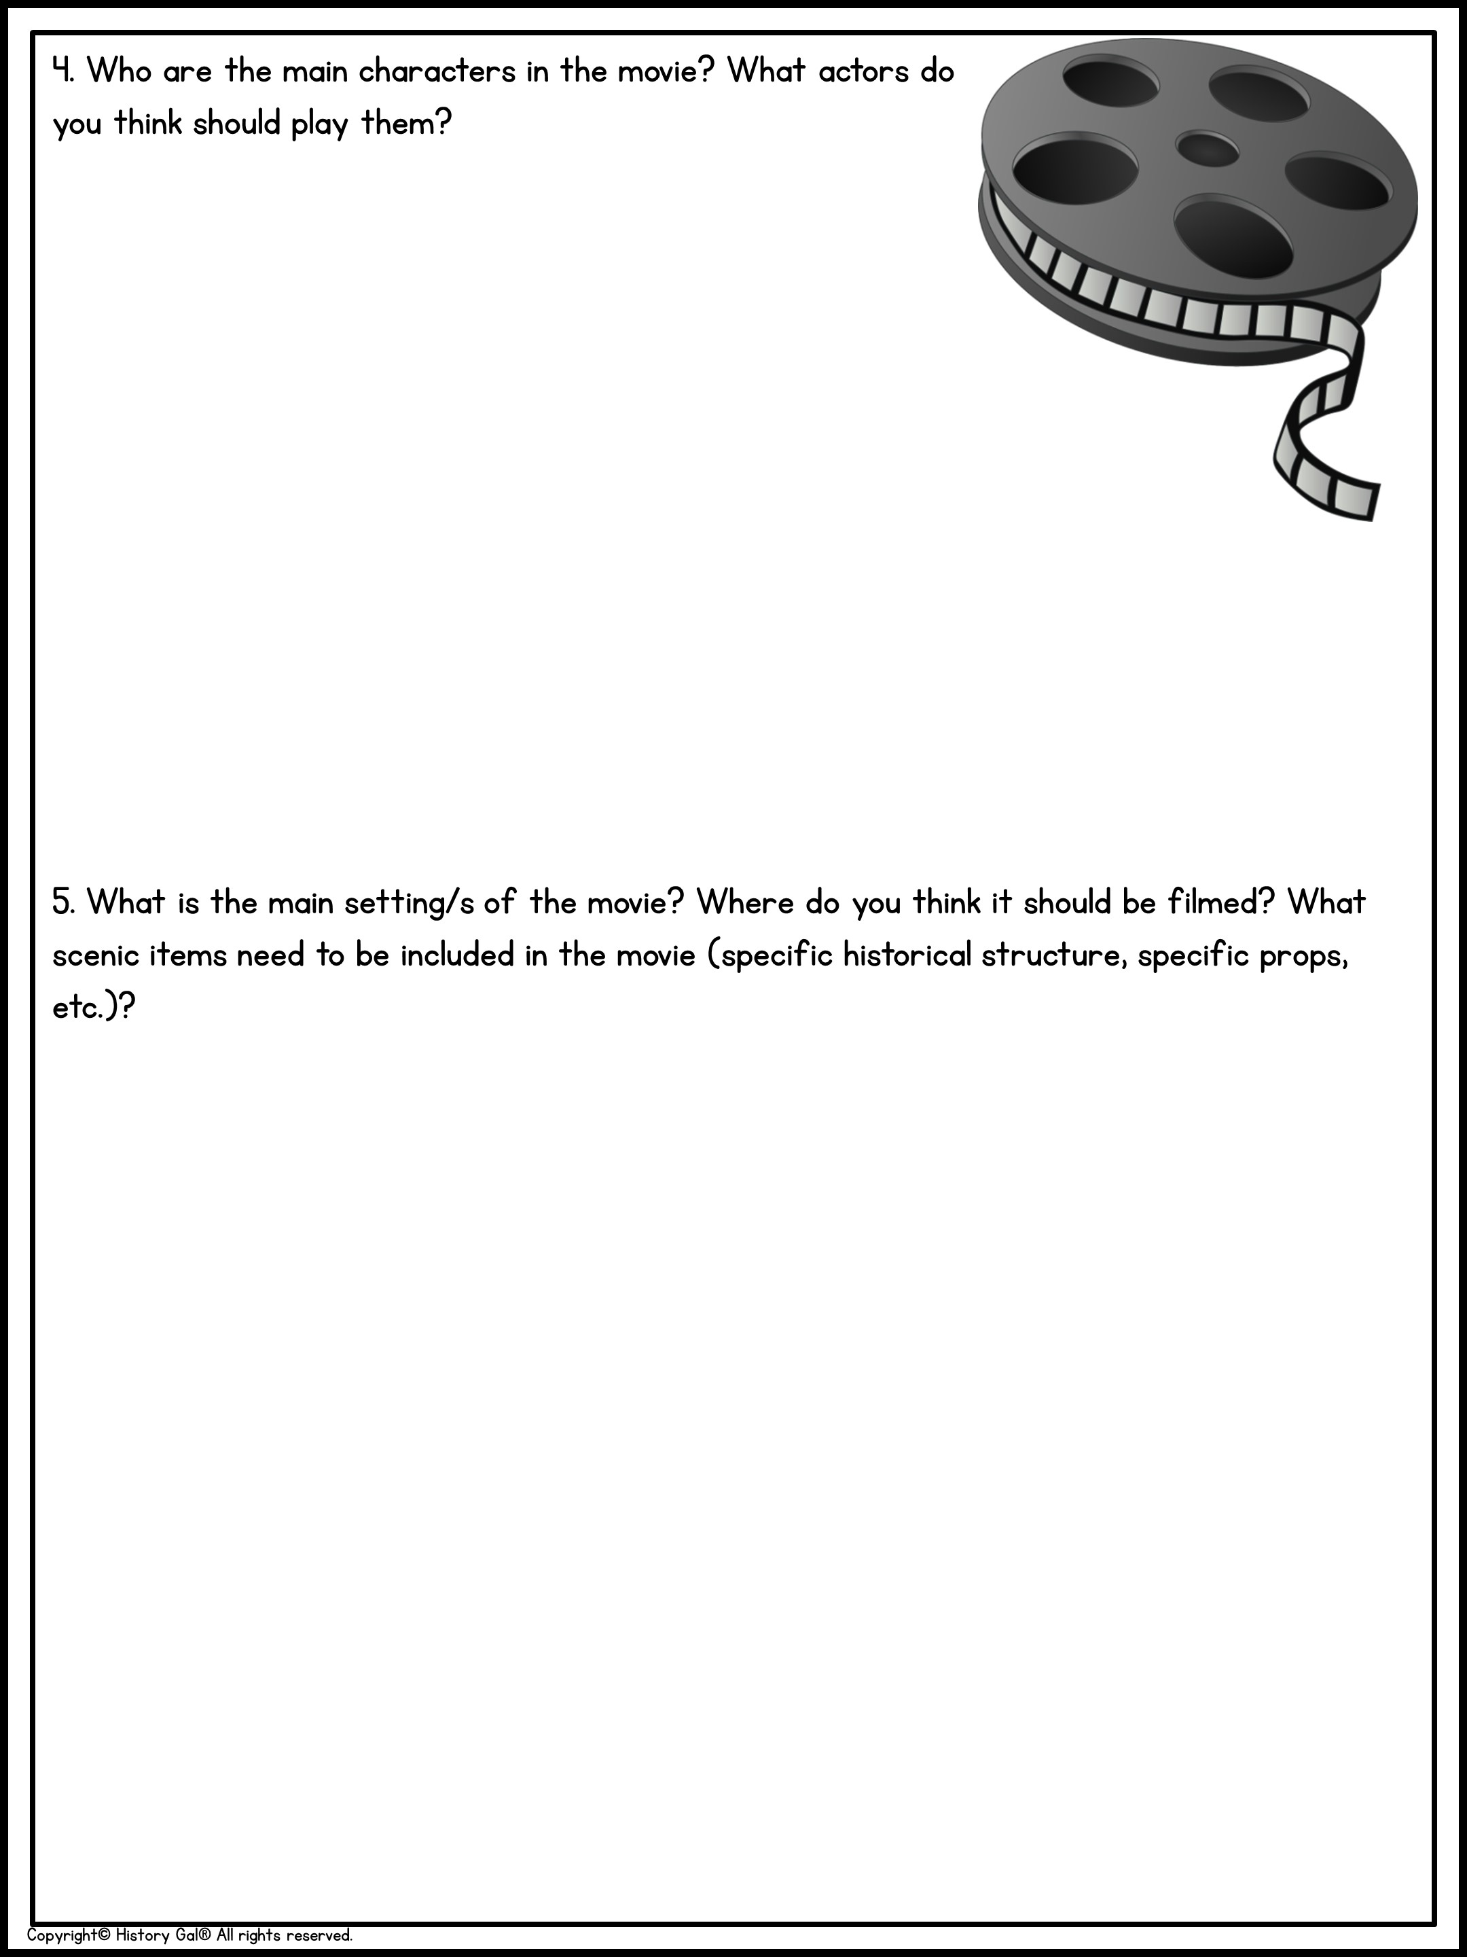

Slide 3
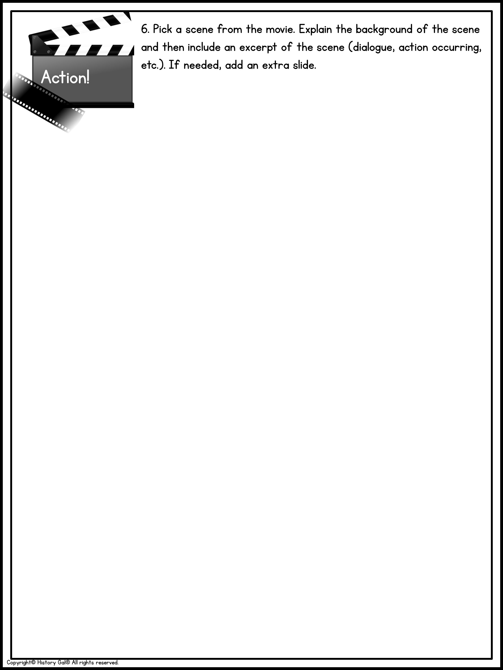

Slide 4
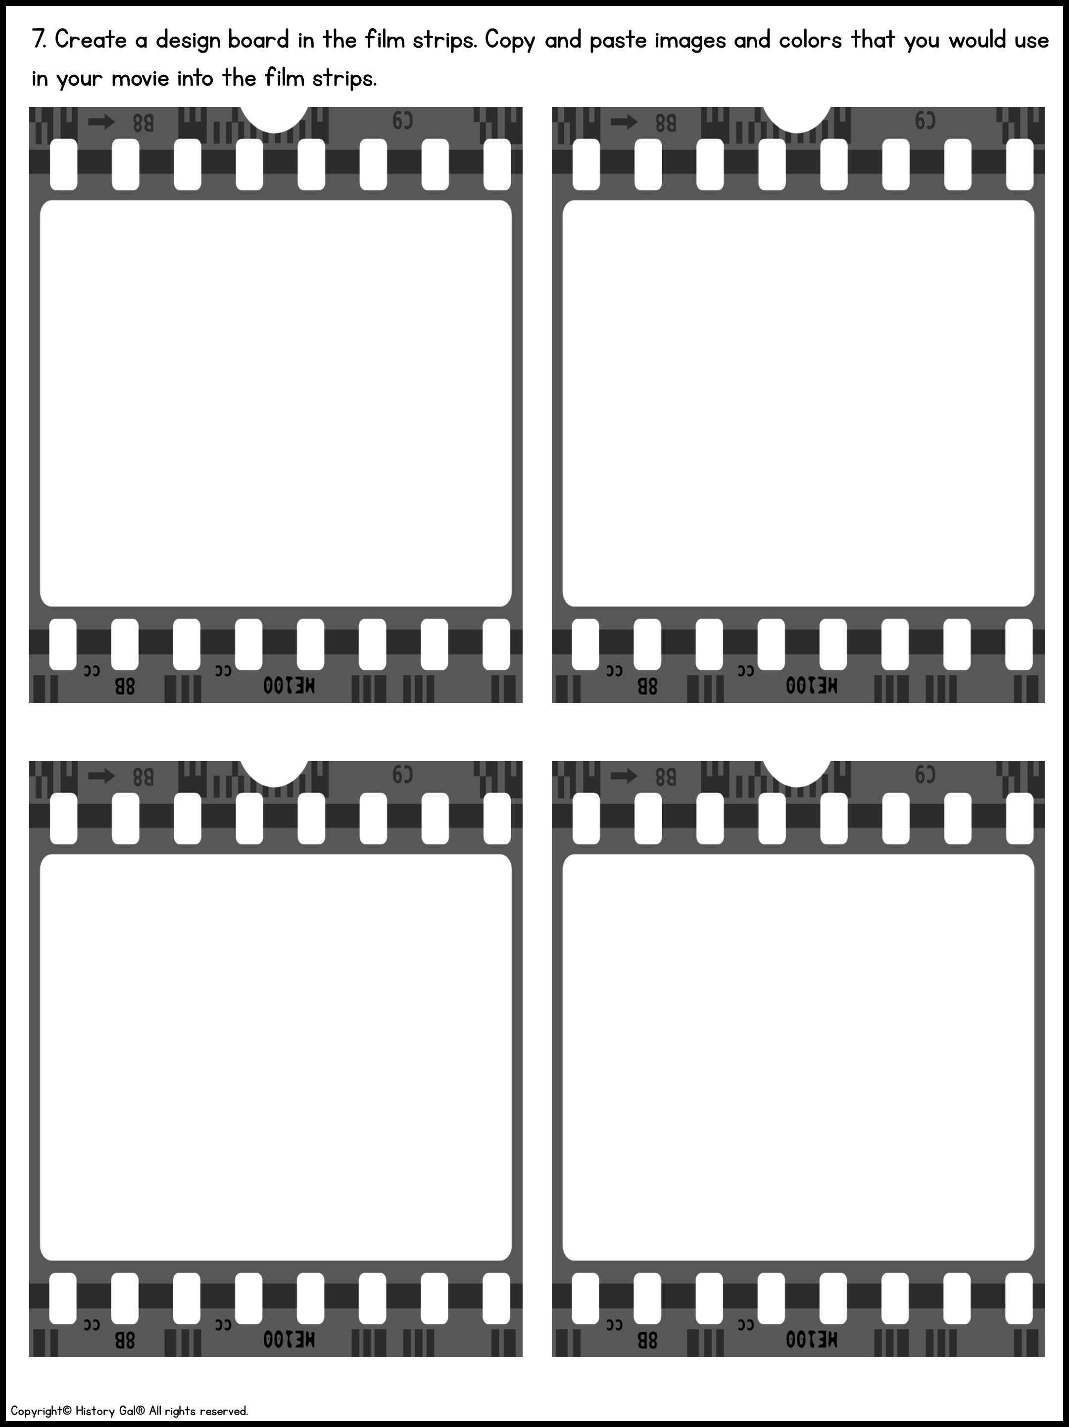
Delete a text box by right clicking on the box and choosing the ‘cut’ option or use the ‘delete’ or ‘backspace’ key on your keyboard.
Use toolbar to add images
Use toolbar to add images
Use toolbar to add images
Use toolbar to add images

Slide 5


